Slide 1
GAN: Anime Faces
Brandon Tran
Project start: 11/30

Slide 2
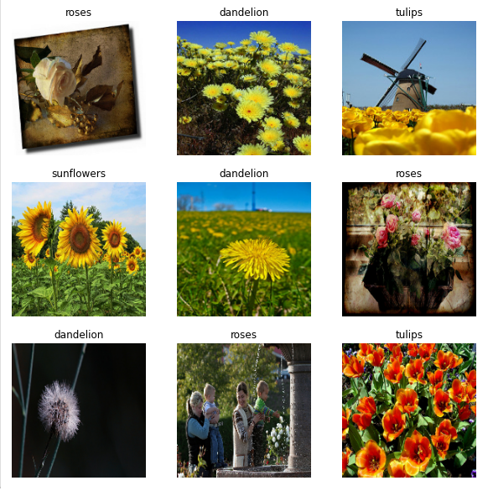
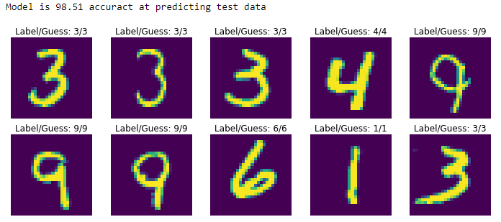
Hello world!
The “Hello World” equivalent in the ML space is the classic Classifier model
In early November 2020 I’ve taken the time to do such project and understand the mathematics
Using the provided TensorFlow example (Left) on flow classification, I created one for MNIST (right)

Slide 3
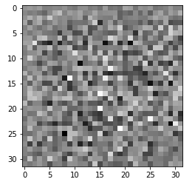
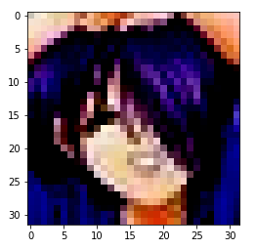
Problem Statement
What next? -- GANs – Generative Adversarial Networks
A classifier is 1-dimensional, it can only tell you what it is looking at based on your training data
What if the model could create you new images/music/text that you never trained it on?
Can we turn noise
Into anime faces?

Slide 4
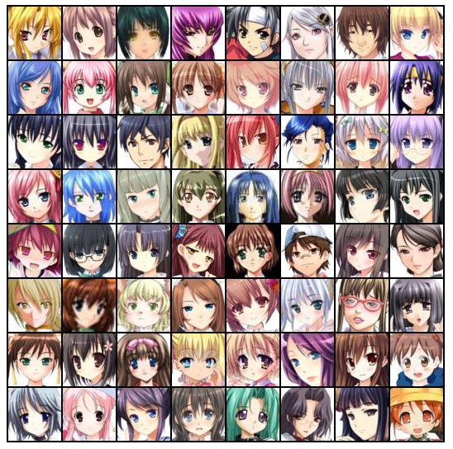
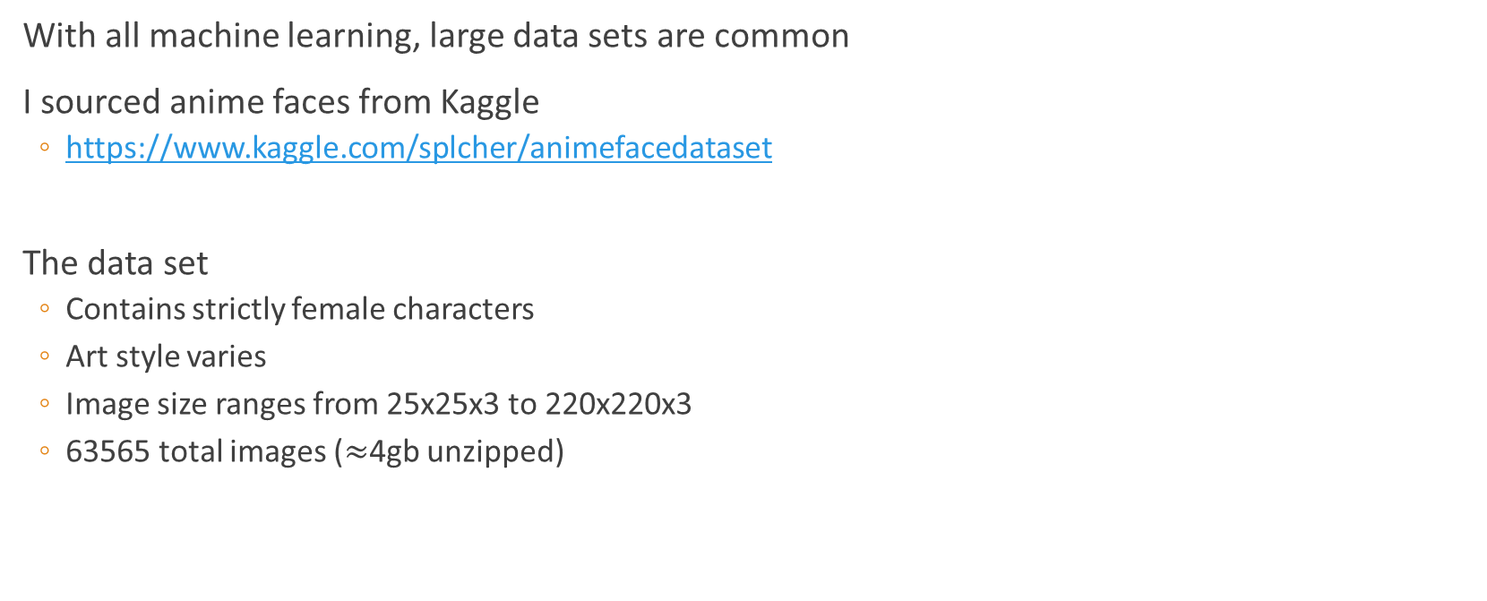
Data set
With all machine learning, large data sets are common
I sourced anime faces from Kaggle
https://www.kaggle.com/splcher/animefacedataset
The data set
Contains strictly female characters
Art style varies
Image size ranges from 25x25x3 to 220x220x3
63565 total images ($≈$4gb unzipped)

Slide 5
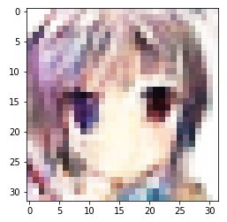
Basic Understanding of GANs
GANs are called adversarial networks because you have 2 separate neural networks fighting one another
Real (✓)
D – Trained on real data to tell real vs fake
Is a basic classifier model
G – Trained via the Discriminator
Takes in noise and generates images to be tested
D aims to lower misclassification rate
G aims to increase misclassification rate
Discriminator (D)
Generator (G)
Fake (x)

Slide 6
Best part of GAN
All you need is the Generator!
The generator has been trained to take white noise and convert it into your desired product
Once the Generator (G) has been trained via backpropagation from the Discriminator’s (D) ability to detect Real vs Fake
The discriminator is no longer needed, it is tossed aside and forgotten
Now any time you want to see a new generated image, you feed in another sample of random noise.
Eg: NVIDA has created a “Thispersondoesnotexist” website which has a generator trained on creating realistic people (and background to go along with that) upon loading the webpage.

Slide 7
Some math
Like the classification problem, gradient descent is used to min/max the loss function
Here we maximize on D --- to achieve a discriminator that is good at telling real for real and fake for fake
Here we minimize on G --- to achieve a generator that is good at fooling the discriminator
Notice the first term has no G, because the generator’s job is only to create fake images that will fool the system, not to sabotage real images in the dataset
Log Prob that D predicts x (real image) as real
Log Prob that D predicts z (fake image) as fake

Slide 8
Progress
1 – Dataset is loaded
2 – Data scrubbing ---- Images are inspected & prepped for ML
3 – Create the Generator
4 – Create the discriminator
5 – Define the loss function
6 – Create a checkpoint system
7 – Define training function
8 – Execute training
9 - Results

Slide 9
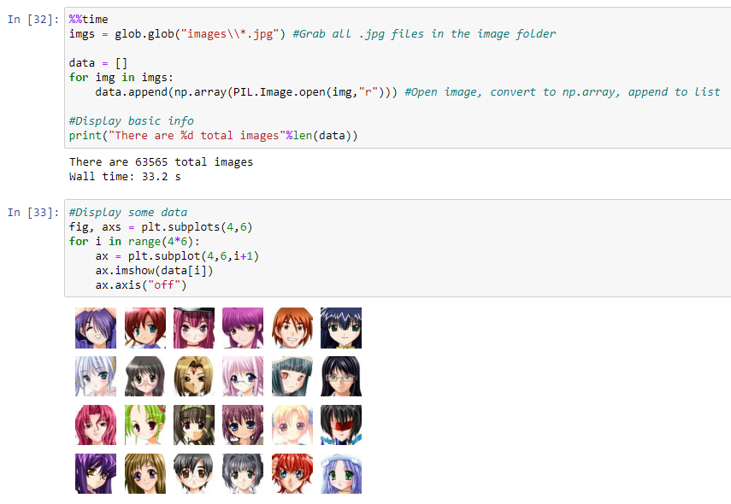
1 – Dataset is loaded
Data was downloaded from Kaggle
Images were unzipped and put into “images\\”
Using Glob, it is very easy to grab all “.jpg” files
Data appended to a list
Upon initial inspection, images look good
Great!

Slide 10
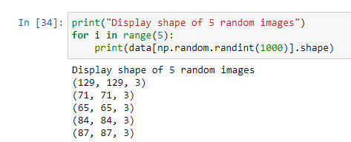
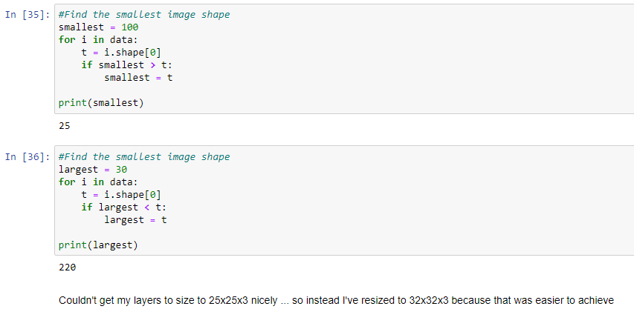
2 – Data scrubbing (1/3)
For image processing, our neural network expects a strict node format
The images however are of varying sizes – need uniformity
Initially I shot for 25x25, however when building the hidden layers an image size of 32x32 was easier to achieve --- and allows for more image resolution (considering this will downsample the majority of the data set)

Slide 11

2 – Data scrubbing (2/3)
Duplicate images exist in the dataset:
Programmatic solution would be to find images with similar shape && file-size
However that could indiscriminately delete some images which aren’t duplicates
I opted to manually pass through the image set a few times and eliminate images manually
Not ideal and likely missed a few duplicates which aren’t right next to one another

Slide 12
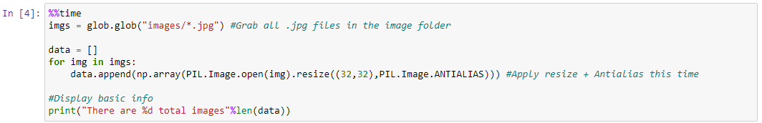
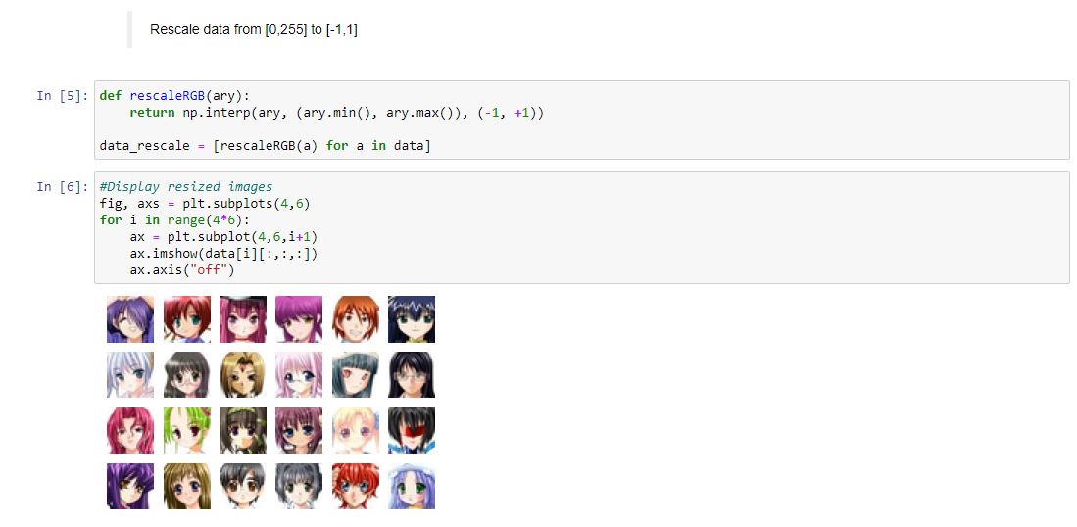
2 – Data scrubbing (3/3)
1) Rescale all images to 32x32 & apply some anti-alias to aid in image quality
2) Rescale RGB from [0,255] to [-1,1] to aid in computation & eliminate large number bias
“Why not [0,1]?”
A random-normal(0,1) as default by numpy will span [-1,1] with an average value of 0.
If the RGB values are [0,1] then the average is 0.5
This makes creating RGB(0,0,0) will be difficult
This is the color for black which is quite prevalent
3) Convert to Tensor.Object()

Slide 13
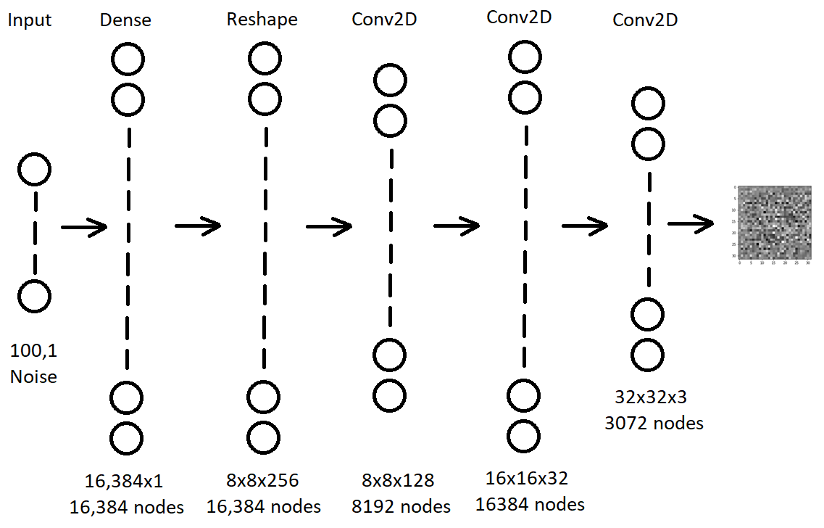
3 – Create the generator (1/2)
Noise will be fed into the generator and its task will be to generate 32x32 images
The generator structure is shown ----->
Layers
Input
The 100x1 noise randomly generated
Dense
Initial layer to process the noise
Reshape
To process into the shape of an image
Conv2D layers
Discover features (edges, shapes, eyes/nose/hair)
Gradually shape from 8x8x256 to 32x32x3
Output
32x32x3 image

Slide 14
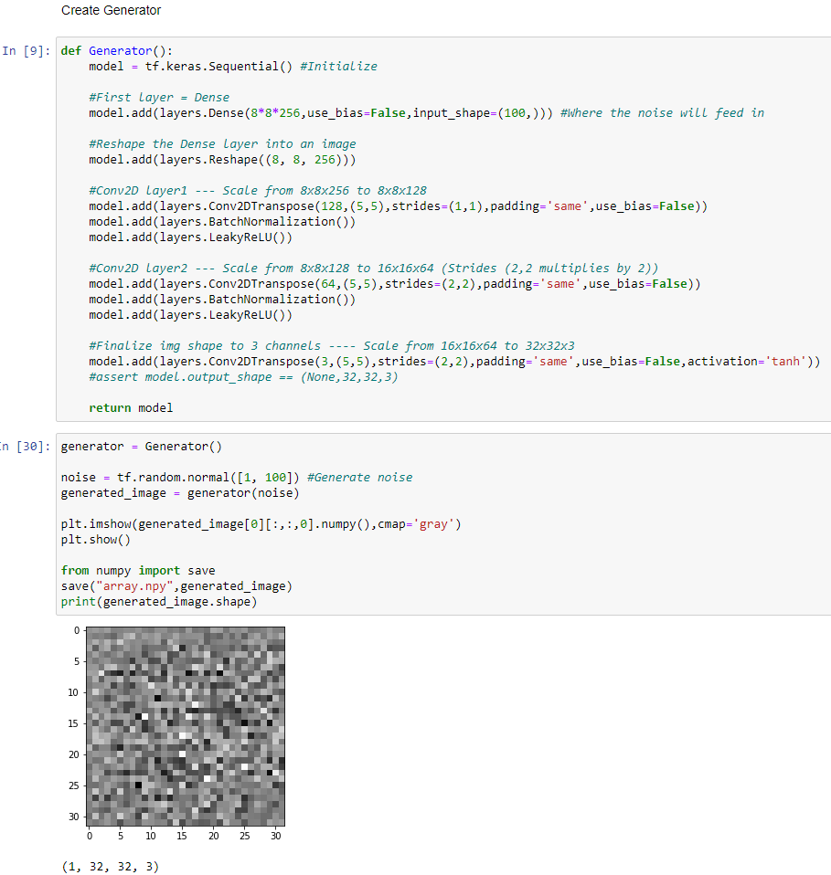
3 – Create the generator (2/2)
Here is the code
The model is initialized via Sequential
The Dense layer will accept the (100,1) noise sample that we want to randomly generate
The noise is reshaped to a 8x8x256 image
Conv2D used to scale down to 128 channels
Conv2D used to scale down to 64 channels
Conv2D used to scale down to 3 channels
Notes
The kernel number dictates the # channel
Strides dictates the image expansion
Ex: Strides=(1,1) maintains the image shape while Strides=(2,2) doubles the image shape
LeakyReLU is ReLU but negative numbers are not 0 and instead a small negative value (to allow for model movement when output is negative)

Slide 15
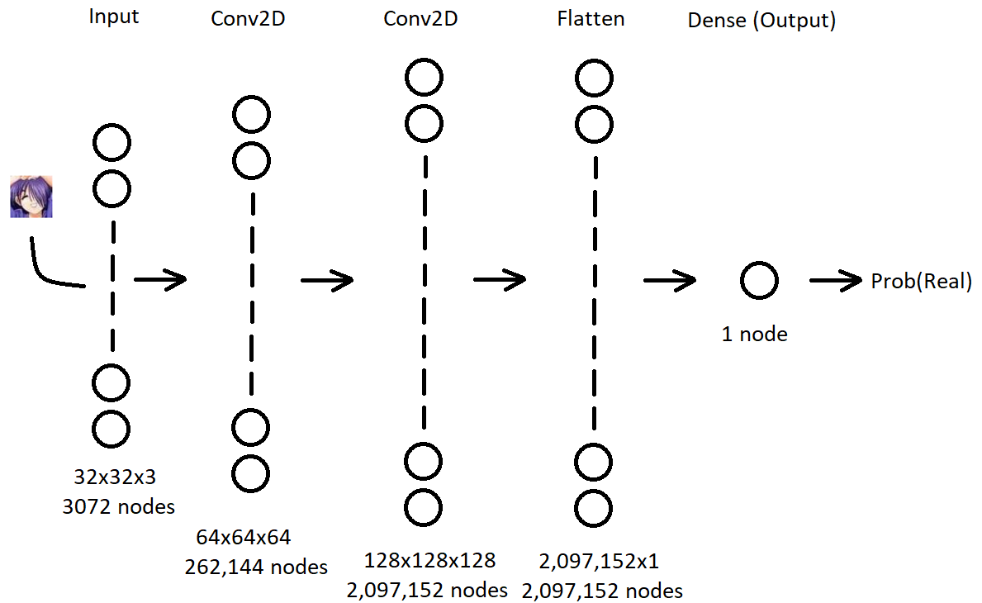
4 – Create the discriminator (1/2)
A 32x32x3 image (real or fake) will be fed into the discriminator and it’ll have to determine if it is an image from the dataset (real) or generated (fake)
Layers
Input
32x32x3 image either from dataset or generator
Conv2D layers
To process image features
Flatten
Convert to linear vector
Dense (Output)
A singular probability that the image is Real (from dataset)

Slide 16
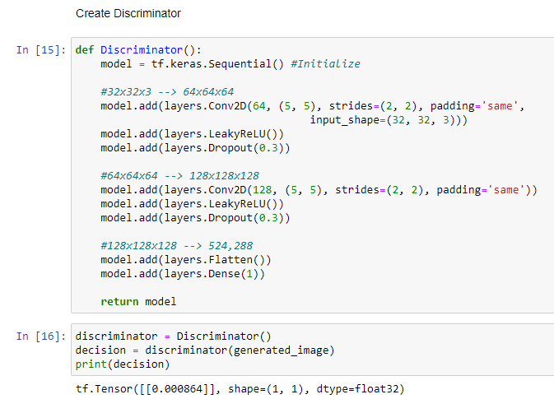
4 – Create the discriminator (2/2)
Here is the code
Model initialized via Sequential
Conv2D layers to process & learn features
Dropout layers to reduce model tendency to overfit
Flatten to convert XYZ image into linear array
Singular Dense node to compute probability
Notes
LeakyReLU is ReLU but negative numbers are not 0 and instead a small negative value (to allow for model movement when output is negative)
Funny enough, the initial random weights/bias did a good job describing noise as absolutely fake w/ Probability of 0.08% real

Slide 17
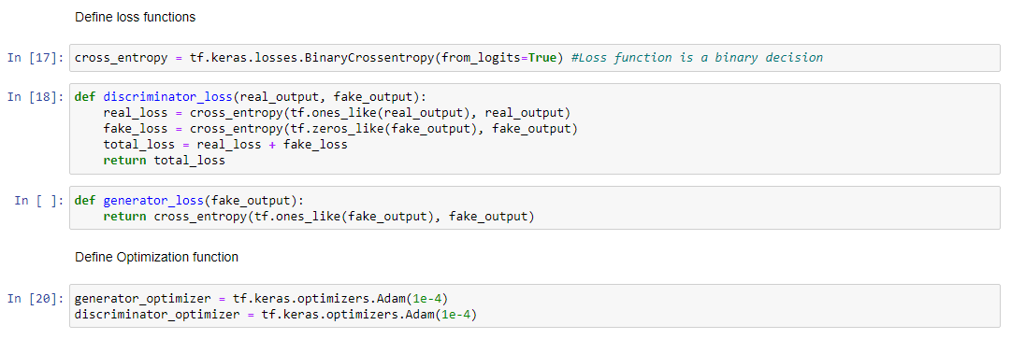
5 – Define the optimizer/loss function
Using Keras loss functions, it logically makes sense to set the loss to the Discriminator to BinaryCrossEntropy()
Binary because the discriminator is making a binary decision --- Real or Fake
Further reading: https://towardsdatascience.com/understanding-binary-cross-entropy-log-loss-a-visual-explanation-a3ac6025181a
Optimizer will just default to adam

Slide 18
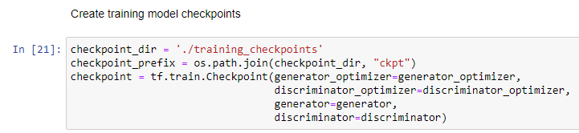
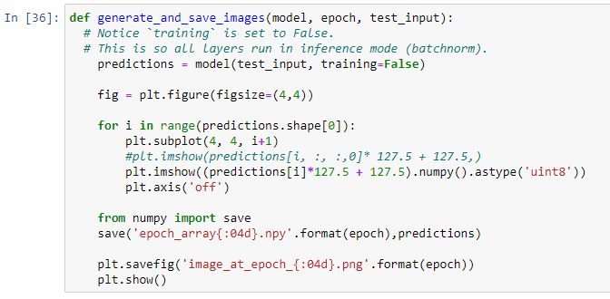
6 – Create checkpoint system
(L) Allows resuming a model from a checkpoint (R) Function to generate test predictions

Slide 19
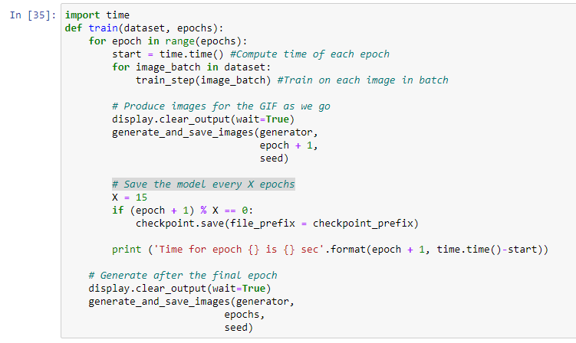
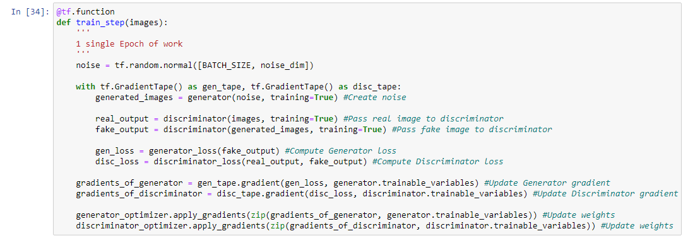
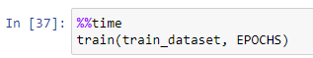
7 – Define training function
(L) Define 1 epoch
Create noise
Feed noise through generator
Ask discriminator to process real & generated img
Compute loss
Update gradients & subsequently weights
(R) Define a train function which runs X epoch of train_step and executes checkpoint & previews of current progress

Slide 20
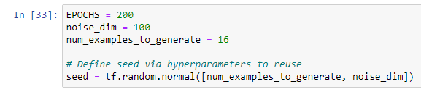
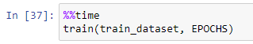
8 – Execute Training
Now that everything is set up
Simply execute with hyperparameters:
Define epochs, dimension of noise, and samples to generate for generator preview
Define batchsize and create train_dataset object with shuffle & batch definitions
Execute training

Slide 21
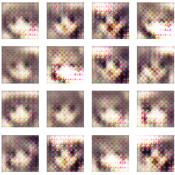
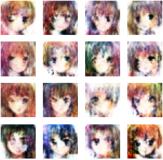
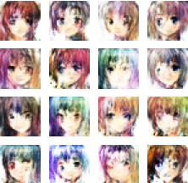
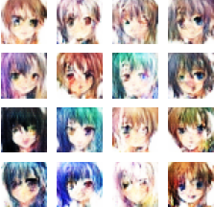
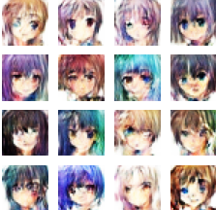
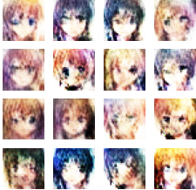
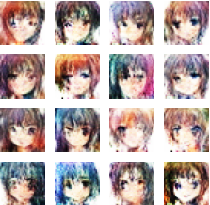
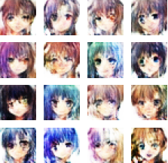
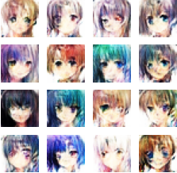
9 – Results
1
25
50
75
100
125
150
175
200

Slide 22
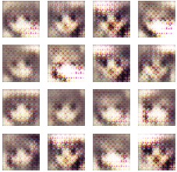
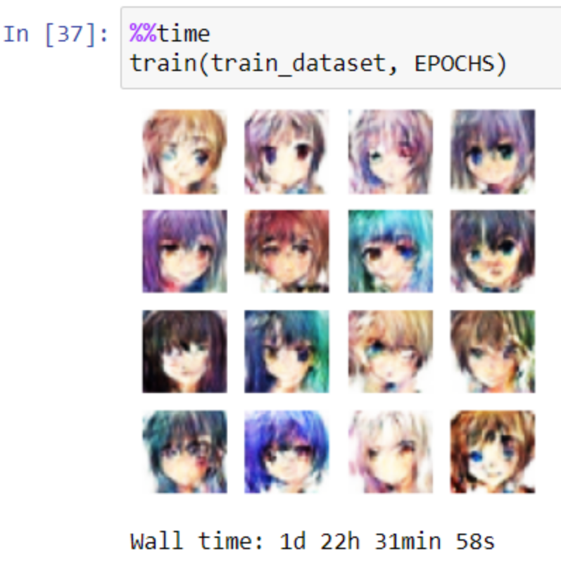
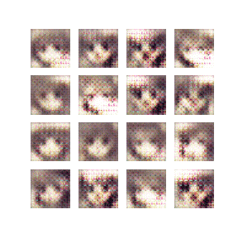

Result – 200 iterations gif
Epoch 1
Epoch 200
Animated Gif:

Slide 23
Discussion
•Generated Images
Poor quality/low-res
Artifacts exist in some of the previews (Eyebrows and hair that “smudge” the eye or other facial features)
Heterochromia (two eye colors) prevalent in many generated images when dataset likely only contains a handful of such faces
This could suggest that the generator is not learning correct features!
•Loss function graph is non-existent (Need to create code for that still) and would aid in troubleshooting
•Processing Time
It took nearly 2 days!
Need to research how to use GPU
**UPDATE** Solution is to follow this youtube video (https://www.youtube.com/watch?v=qrkEYf-YDyI)
Computation sped from ~300s/epoch to ~9s/epoch

Slide 24
Conclusion
Improvements that could be made:
Running for longer epoch
Most GANs I see online run for 500~1000 epoch (or even upwards of +5000)
it all depends on the complexity of the problem --- (Ex: 32x32x3 faces vs 8x8x1 MNIST numbers)
Re-define the Generator and Discriminator layers
2 million nodes in a single layer may be a bit much
Leads to overfitting & longer computation time
Could apply dropout() to Generator layer to aid in overfitting tendency of CNNs
May want to play around with kernel-size and the initial Dense() layer on the Generator
May want to investigate ReLU vs LeakyReLU
Many examples online have success with simply ReLU, but others preach the benefits of LeakyReLU
Readings:
1) https://towardsdatascience.com/gan-ways-to-improve-gan-performance-acf37f9f59b
2) https://jonathan-hui.medium.com/gan-why-it-is-so-hard-to-train-generative-advisory-networks-819a86b3750b#1d4a

